Slide 1
Software engineering
Professor Sabina Umirzakova

Slide 2
Software Development Life Cycle (SDLC) Models
The Software Development Life Cycle (SDLC) is a structured approach used to design, develop, test, and deploy software efficiently and with high quality.
SDLC consists of different models, each defining the steps and methodologies to be followed during software development.

Slide 3
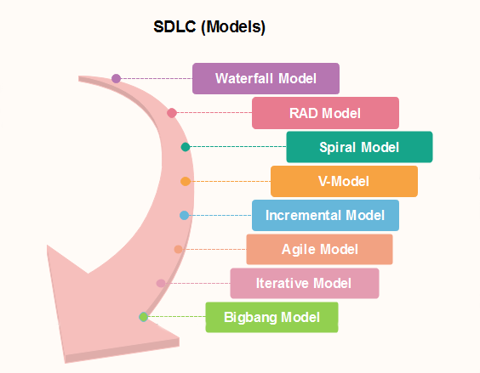
SDLC Models
Here, are some important models of SDLC life cycle: See later

Slide 4
Waterfall model
The waterfall model was first defined by Winston W. Royce in 1970 and has been widely used for software projects ever since.
The Waterfall Model is the oldest and most traditional software development life cycle model.
It follows a linear and sequential approach, meaning each phase must be fully completed before moving to the next.
It is called the "Waterfall" because the development process flows downwards like a waterfall.

Slide 5
Waterfall model
The waterfall model is a linear, sequential approach to the software development lifecycle that is popular in software engineering and product development.
The waterfall model uses a logical progression of SDLC steps for a project, similar to the direction water flows over the edge of a cliff.
It sets distinct endpoints or goals for each phase of development.
Those endpoints or goals can not be revisited after their completion.

Slide 6
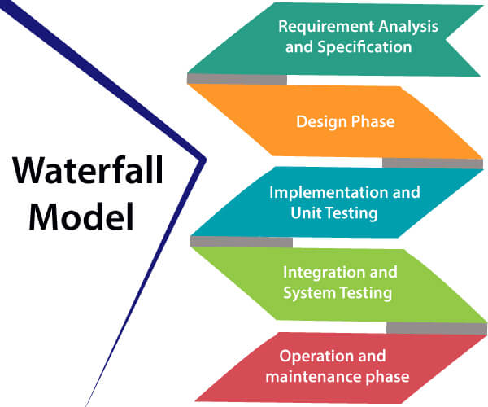
Waterfall model

Slide 7
Waterfall model
The Waterfall model is an example of a Sequential model.
In this model, the software development activity is divided into different phases and each phase consists of a series of tasks and has different objectives.
The Waterfall model was used to develop enterprise applications like Customer Relationship Management (CRM) systems, Human Resource Management Systems (HRMS), Supply Chain Management Systems, Inventory Management Systems, Point of Sales (POS) systems for retail chains, etc.
Also, for example, the software development arm of Toyota has been traditionally working with waterfall models.

Slide 8
Waterfall model
The waterfall model was also used in banking, healthcare, control systems for nuclear facilities, space shuttles, etc.
These days most projects need to be performed by means of more flexible models for the optimal software development process.
The Waterfall model is mostly used on smaller projects where the requirements are clear and there is no need to change them quickly.
It is a well-structured approach.
The stages are well-defined and easy to understand for all.

Slide 9
Waterfall model
This model has five phases
Requirements analysis and specification,
Design,
Implementation Unit testing,
Integration and system testing,
Operation and maintenance.
The steps always follow in this order and do not overlap. The developer must complete every phase before the next phase begins.

Slide 10
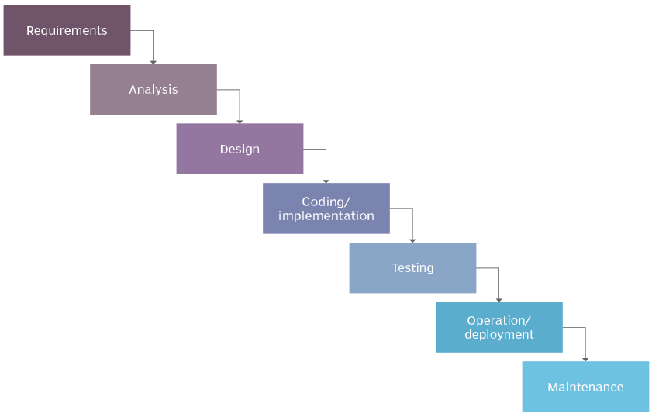














Waterfall model

Slide 11
Waterfall: Requirements analysis and specification phase
Goal: Understand the exact requirements of the client. Activities
Conduct meetings with stakeholders.
Gather functional & non-functional requirements.
Create a Software Requirement Specification (SRS) document.
Ensure requirements are well-documented and approved.
Output SRS Document (Software Requirement Specification) → A document containing all requirements.

Slide 12
Waterfall: Design Phase
Goal: Convert requirements into a technical plan. Activities
Define architecture, database structure, and technology stack.
Create UI/UX wireframes and system flowcharts.
Define hardware & software requirements.
Output System Design Document (SDD) → A blueprint of the system’s structure.

Slide 13
Waterfall: Implementation
Goal: Write the actual code based on the design documents. Activities
Developers write source code in a chosen programming language.
Code is developed module by module.
Internal unit testing is performed to check individual functions.
Output A fully developed software ready for testing.

Slide 14
Waterfall: Testing
Goal: Identify and fix bugs & defects before deployment. Activities
Perform functional testing (does the software work as expected?).
Conduct system testing (does the software integrate correctly?).
Perform user acceptance testing (UAT) with end-users.
Output: A bug-free, fully tested software product.

Slide 15
Waterfall: Deployment
Goal: Deliver the software to the client or end-users. Activities
Deploy the software in a live environment.
Conduct performance monitoring.
Provide user training and documentation.
Output Software is available for use by customers or employees.

Slide 16
Waterfall: Maintenance
Goal: Provide long-term support & updates.
Activities
Fix bugs reported by users.
Release updates & security patches.
Improve performance & add new features.
Output A stable and well-maintained software product.
https://www.youtube.com/watch?v=Y_A0E1ToC_I&ab_channel=JohnnyKhoury

Slide 17
When to use SDLC Waterfall Model
✅ Best suited for: ✔ Small to Medium-Sized Projects with clear requirements ✔ Government & Military Projects (due to strict process compliance) ✔ Medical Software & Banking Applications (where documentation is essential) ✔ Embedded Systems & Hardware Development
❌ Avoid it for: ❌ Projects with evolving requirements (Agile is better) ❌ Fast-changing environments (Spiral is more flexible) ❌ High-risk projects requiring early feedback

Slide 18
Advantages of Waterfall model
Easy to Understand & Use → The simple, structured approach makes it easy to manage.
Clear Documentation → Each phase has detailed documentation, helping future development.
Well-Suited for Small Projects → Works well if requirements are stable and well-defined.
Minimal Customer Involvement Required → Developers work independently without constant client feedback.
Early Planning Saves Cost → Since everything is well-planned from the start, budget overruns are minimized.

Slide 19
Disadvantages of Waterfall model
No Flexibility for Requirement Changes → Once the project starts, changes are hard to implement.
Late Testing Phase → Bugs are only discovered after development, increasing fixing costs.
Slow Delivery Time → The full product is delivered at once, so customers wait months or years to see results.
Not Suitable for Complex Projects → Large projects need iterative models like Agile or Spiral.
High Risk → If an error occurs in early stages, it propagates through all later stages, causing major problems.

Slide 20
Example of Waterfall Model in Real Life
Imagine you are building a house. You can’t start painting before the walls are built, and you can’t build walls before the foundation is laid. The construction follows a strict step-by-step process, just like the Waterfall model.
Phases in a Construction Project (Waterfall Style)
Requirement Analysis → Decide the size, budget, and materials.
Design → Create blueprints for the house.
Implementation → Build the foundation, walls, and roof
Testing → Inspect for leaks, electrical safety, and plumbing.
Deployment → Move into the house.
Maintenance → Repair damages and make improvements.

Slide 21
Example: Calculator
Simple calculator using the Waterfall Model, implementing three basic functions: addition (+), subtraction (-), and multiplication (*).

Slide 22
Step 1- Requirement Analysis
Requirements
The user should be able to enter two numbers.
The user should be able to choose an operation (addition, subtraction, or multiplication).
The calculator should display the result.
The program should keep running until the user chooses to exit.
Output: Software Requirement Specification (SRS) Document

Slide 23
Step 2- System Design
System Architecture
A function for each mathematical operation.
A menu system for user interaction.
A loop to allow multiple calculations.
Output: System Design Document (SDD)

Slide 24
Step 3- Implementation (Coding)
Action: Simple Calculator code with 3 functions (def add(a, b), def subtract(a, b), def multiply(a, b)).
Output: *A working calculator with three operations (+, -, *)

Slide 25
Step 4- Testing
Test Cases:
Output: All test cases pass successfully!
Test Scenario | Input | Expected Output
Add numbers | 2, 3, + | 5
Subtract numbers | 10, 4, - | 6
Multiply numbers | 6, 7, * | 42
Enter non-number | "abc", 5 | Error message
Enter invalid choice | 5 | Error message
Exit program | 4 | Program terminates

Slide 26
Step 5- Deployment
The script is now deployed for users to run on their computers.
Output: Users can download and run the script.

Slide 27
Step 6- Maintenance
Future Improvements
Add division (/).
Add exponentiation (^).
Create a GUI version using Tkinter.
Output: New versions released with more features.

Slide 28
All steps
Requirement Analysis → Defined how the calculator should work.
System Design → Planned functions and user interaction.
Implementation → Wrote the Python program.
Testing → Verified correct outputs.️
Deployment → Delivered the program for use.
Maintenance → Considered future improvements.

Slide 29
Example: "Greeting Message" Program
Create a very simple Python program that follows the Waterfall Model step by step.
This program will ask the user for their name and age, then display a personalized greeting.

Slide 30
Step 1- Requirement Analysis
Requirements
The program should ask for the user's name.
The program should ask for the user's age.
The program should display a greeting message using the provided information.
The program should exit after displaying the message.
Output: Software Requirement Specification (SRS)

Slide 31
Step 2- System Design
System Architecture
The program will use input() to collect user data.
The program will use print() to display the message.
No loops or complex logic—just a simple linear flow.
Output: System Design Document (SDD)

Slide 32
Step 3- Implementation (Coding)
Make a code with (def get_name(), def get_age(), def display_greeting(name, age)).
Output:
Enter your name: Sabina
Enter your age: 34
Hello, Sabina! You are 34 years old.

Slide 33
Step 4- Testing
Test Cases
Output: All test cases pass successfully!
Test Scenario | Input | Expected Output
Enter name & age | Sabina, 34 | "Hello, Sabina! You are 34 years old."
Enter only numbers in name | 123, 20 | "Hello, 123! You are 20 years old."
Enter special characters in name | @Pooh!, 30 | "Hello, @Pooh!! You are 30 years old."
Leave name empty | (press Enter), 18 | "Hello, ! You are 18 years old."

Slide 34
Step 5- Deployment
The script is now deployed for users to run on their computers.
Output: Users can download and run the script.

Slide 35
Step 6- Maintenance
Future Improvements
Add error handling (such as, check if age is a number).
Add looping functionality so users can restart.
Add GUI version using Tkinter.
Output: New versions released with more features.

Slide 36
All Steps
Requirement Analysis → Defined what the program should do.
System Design → Planned how the program will work.
Implementation → Wrote the Python program.
Testing → Verified correct outputs.
Deployment → Delivered the program for use.
Maintenance → Considered future improvements.

Slide 37
Group 1: Student Grading System
Objective
Develop a Python program to calculate a student’s average grade and assign a letter grade (A-F).
Requirements
Ask for the student's name.
Input three exam scores.
Calculate the average score.
Assign a letter grade based on predefined rules.
Display the name, average score, and letter grade.
Bonus: Add input validation (ensure scores are between 0 and 100).

Slide 38
Group 1: Student Grading System
Expected Output Example
Enter student name: Alice
Enter first exam score: 85
Enter second exam score: 90
Enter third exam score: 78
Student: Alice
Average Score: 84.33
Grade: B
202035248 | Choi Yoon
202139410 | NGUYEN TUAN QUANG
202239627 | YUAN HAOCHENG
202339193 | HOANG VAN HAI

Slide 39
Group 2: Simple Banking System
Objective
Create a Python program that simulates a basic banking system, allowing deposits, withdrawals, and balance checks.
Requirements
Start with an initial balance example, 1000.
Provide a menu with options:
Deposit money (+)
Withdraw money (-)
Check balance
Exit
Ensure that withdrawals don’t exceed the balance.
Display updated balance after each transaction.
Bonus: Implement error handling example, reject withdrawals that exceed the balance.

Slide 40
Group 2: Simple Banking System
Expected Output Example
Welcome to Simple Bank!
1. Deposit
2. Withdraw
3. Check Balance
4. Exit
Enter choice: 1
Enter deposit amount: 500
New Balance: 1500
Enter choice: 2
Enter withdrawal amount: 300
New Balance: 1200
202339674 | ZHOU ZIXUAN
202438378 | KATWAL MANAV
202438379 | SHUKIRILLAEV MUKHAMMADSODIK SHERZODBEK UGLI
202438388 | BEKMIRZAEV SALOHIDDIN AZIZBEK UGLI

Slide 41
Group 3: Age Categorization Program
Objective
Develop a Python program that categorizes a person’s age group.
Requirements
Ask the user for their name.
Ask for their age.
Categorize them into:
Child (0-12)
Teenager (13-19)
Adult (20-59)
Senior (60+)
Display a personalized message.
Bonus: Handle cases where age is negative or non-numeric.

Slide 42
Group 3: Age Categorization Program
Expected Output Example
Enter your name: Name
Enter your age: 25
Hello, Name! You are classified as an Adult.
202438392 | ARABBOEV OYATILLO ZAFARBEK UGLI
202438404 | AKHMEDOV YUSUFJON MAKHAMMAD UGLI
202438418 | TURAEV LAZIZBEK ISMATILLA UGLI
202439212 | SABIROV ASADBEK

Slide 43
Group 4: Temperature Converter
Objective
Develop a Python program that converts Celsius to Fahrenheit and vice versa.
Requirements
Ask the user to choose a conversion type:
Celsius to Fahrenheit
Fahrenheit to Celsius
Ask for the temperature value.
Perform the conversion:
Fahrenheit = (Celsius × 9/5) + 32
Celsius = (Fahrenheit - 32) × 5/9
Display the converted value.
Bonus: Add input validation (ensure input is numeric).

Slide 44
Group 4: Temperature Converter
Expected Output Example
Choose conversion type:
1. Celsius to Fahrenheit
2. Fahrenheit to Celsius
Enter choice: 1
Enter temperature in Celsius: 25
Temperature in Fahrenheit: 77.0°F
202339189 | ADAM IMRAN BIN MAHMUD
202339663 | MUNKHBAYAR LKHAGVA OCHIR
202339667 | XIAO JIAN
202439400 | TRAN NGOC SON

Slide 45
Group 5: Simple Password Generator
Objective
Develop a Python program that generates a random password.
Requirements
Ask the user for password length.
Generate a random password using:
Letters (A-Z, a-z)
Numbers (0-9)
Special characters (!, @, #, etc.)
Display the generated password.
Bonus: Allow the user to choose password strength:
Weak (only letters)
Medium (letters + numbers)
Strong (letters + numbers + special characters)

Slide 46
Group 5: Simple Password Generator
Expected Output Example
Enter password length: 8
Generated Password: A1b@C2d#
202339189 | ADAM IMRAN BIN MAHMUD
202339663 | MUNKHBAYAR LKHAGVA OCHIR
202339667 | XIAO JIAN
202439400 | TRAN NGOC SON

Slide 47
Homework
1. Create your github page and include your HM
2. Prepare program based on description based on WATERFALL MODEL.
3. Prepare detailed presentation:
Requirement Analysis
System Design
Implementation
Testing (Test Cases)
Conclusion
4. Explanation on .ppt 5~10 minutes.
FOR EACH STUDENT WILL BE SEPARATE WORK

Slide 48
202035248 | Choi Yoon | Name Reversal Program. Ask for a user's name and display it in reverse.
202139410 | NGUYEN TUAN QUANG | Odd or Even Checker. Ask for a number and determine if it is odd or even.
202239627 | YUAN HAOCHENG | Simple Tip Calculator. Ask for a bill amount and tip percentage, then calculate the total.
202339193 | HOANG VAN HAI | String Length Counter. Ask for a string and display its length.
202339674 | ZHOU ZIXUAN | Simple Countdown Timer. Ask for a number (seconds) and display a countdown to zero.
202438378 | KATWAL MANAV | Factorial Calculator. Ask for a number and calculate its factorial.
202438379 | SHUKIRILLAEV MUKHAMMADSODIK SHERZODBEK UGLI | Prime Number Checker. Ask for a number and check if it is prime.
202438388 | BEKMIRZAEV SALOHIDDIN AZIZBEK UGLI | Greatest Common Divisor (GCD) Finder. Ask for two numbers and find their GCD.
202438392 | ARABBOEV OYATILLO ZAFARBEK UGLI | Sum of Digits Calculator. Ask for a number and sum its digits.
202438404 | AKHMEDOV YUSUFJON MAKHAMMAD UGLI | Fibonacci Series Generator. Ask for a number and print Fibonacci up to that number.
202438418 | TURAEV LAZIZBEK ISMATILLA UGLI | Find the Largest & Smallest Number in a List. Ask for multiple numbers and find the largest and smallest.
202439212 | SABIROV ASADBEK | Remove Duplicates from a List. Ask for a list of numbers and remove duplicates.
202339189 | ADAM IMRAN BIN MAHMUD | Sort a List in Ascending Order. Ask for numbers and display them sorted.
202339663 | MUNKHBAYAR LKHAGVA OCHIR | Find the Most Frequent Element in a List. Identify which number appears most frequently.
202339667 | XIAO JIAN | Matrix Addition. Ask for two 2x2 matrices and calculate their sum.
202439400 | TRAN NGOC SON | Palindrome Checker. Check if a given word or sentence is a palindrome.
202438377 | KOMILJONOV RAHIMJON AZIZJON UGLI | Count Vowels and Consonants. Ask for a sentence and count vowels/consonants.
202599002 | LINKUTE BRIGITA | Find & Replace a Word in a Sentence. Ask for a sentence and replace a word.
202599003 | VELICKAITE PAULINA | Anagram Checker. Check if two words are anagrams (such as, "listen" and "silent").
202438093 | MUMINOV OLIMJON KANDIYOROVICH | Convert a Sentence to Title Case. Convert text to Title Case (Each Word Starts with Capital Letter).
202139411 | PHAM THI THU TRANG | Copy File Contents. Copy text from one file to another.

